Slide 1
Philip Demeri Springboard Data Science Career Track Capstone Project #1 Predictive Modeling Applied to Rotating between Stock Portfolios that Follow Different Mandates

Slide 2
Aim
To implement machine learning models that effectively rotate between two underlying portfolios so as to engender performance that is better than simply buying and holding one of the underlying portfolios
Three supervised learning algorithms will be implemented: logistic regression, SVM classifier, and random forest classifier

Slide 3
Data – Features
Over 20 years of monthly data consist of the following features:
Chicago Fed National Activity Index – manufacturing and industrial activity
Consumer Price Index – inflation among popular consumer goods
M2 – money supply (i.e., how much money is currently in circulation)
Institute for Supply Management Index – manufacturing metric
Butterfly spread – weighted average of yields at different maturities
Dividend yield spread – difference between two portfolios’ dividend yields

Slide 4
Data – Target
The target is a function of the quarterly returns of two stock portfolios – S&P 600 Small Cap Value Index, and S&P 600 Small Cap Growth Index, where the difference between the two returns is then coerced to a Boolean variable (1 if value outperforms growth, 0 otherwise)
“Value” and “growth” stocks have been shown to respond differently to macroeconomic conditions and the current phase of the economy’s business cycle
The goal is to exploit the features to predict which of the two portfolios is expected to outperform over the next quarter

Slide 5
Wrangling the Data
The features’ periodicities were converted to monthly and missing observations (namely, holidays) were accounted for by filling forward from the previous day
The most important step was to lag the features and project forward the target so as to mitigate any lookahead bias, and the length at which to lag each feature rested on that which correlated best with the continuous target (i.e., which lag produced the strongest relationship with the forward-looking quarterly returns spread)
The features were lagged as follows:
Activity: two months
Inflation: two months
Money supply: two months
Manufacturing: zero months
Butterfly spread: eight months
Dividend yield spread: two months
244 months’ worth of data are partitioned into a training set (first 200 months), a validation set (next 24 months), and a test set (final 20 months)

Slide 6
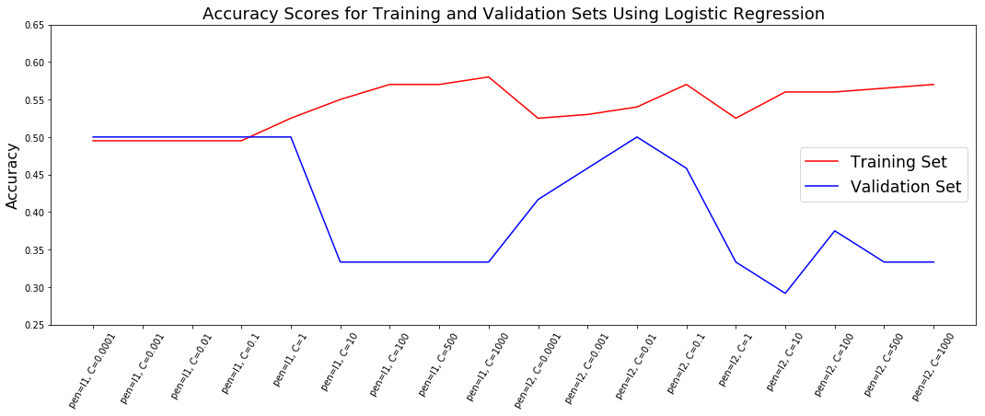
Machine Learning – Logistic Regression
We begin by looping over an array of regularization strengths and alternating between the l1 and l2 penalty

Slide 7
Machine Learning – Logistic Regression
We fail to exceed 60% accuracy on any of the training, validation, or test sets using C = 1000 and the l1 penalty, which led to the best performance on the training data
Implementing GridSearchCV using five folds on the training data, we now see that the best hyperparameters are C = 0.01 and the l2 penalty, but as before, the performance is not extraordinary
 | Loop | GridSearchCV
C | 1000 | 0.01
Penalty | l1 | l2
Training Accuracy | 0.58 | 0.54
Validation Accuracy | 0.33 | 0.5
Test Accuracy | 0.6 | 0.6

Slide 8
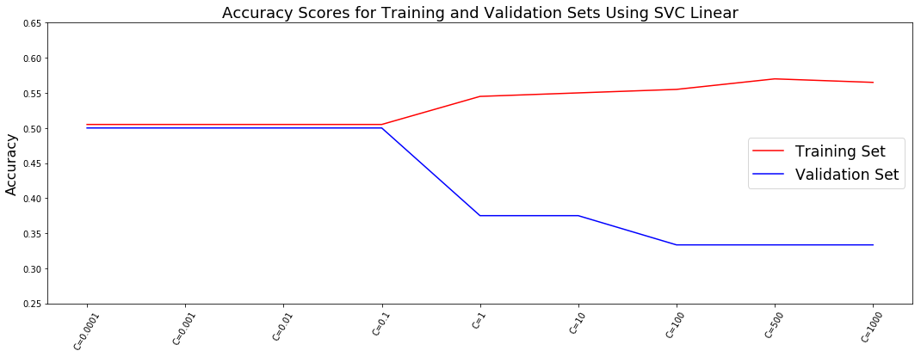
Machine Learning – SVC Linear
We see similar behavior between the accuracies on the training and validation sets using the SVC with linear kernel as we do using the logistic regression model

Slide 9
Machine Learning – SVC Linear
C = 500 generates the highest accuracy on the training data
But as witnessed in the logistic regression model, the higher the value of C (that is, the lesser the regularization strength), the greater the overfitting, evidence by the diverging performances between the accuracies on the training and validation sets

Slide 10
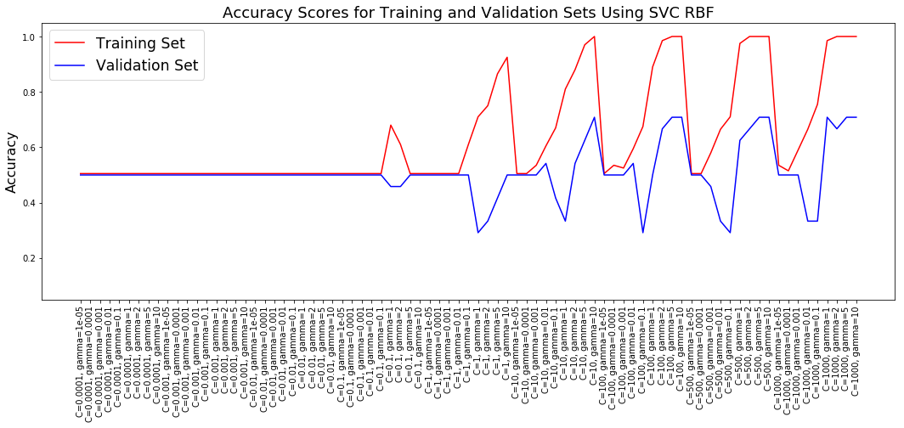
Machine Learning – SVC RBF
When we shift to the SVC model with the RBF kernel, we see improved performance when C and gamma are high

Slide 11
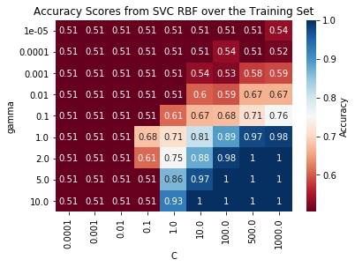
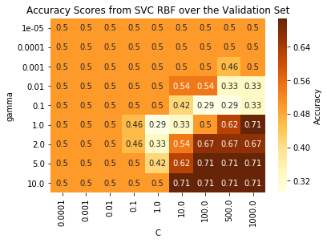
Machine Learning – SVC RBF
Heat maps can better capture the effects of looping over C and gamma

Slide 12
Machine Learning – SVC RBF
An accuracy score of 71% on unseen data (via the validation set) is acceptable, but performance drops dramatically when the model using C = 1000 (high) and gamma = 10 (high) is applied to the test set, where accuracy is only 40%
The further away is the unseen data over time from the training data, the less impressive are the predictions

Slide 13
Machine Learning – Random Forest Classifier
We apply ten-fold GridSearchCV to the training data, iterating over the hyperparameters n_estimators, max_features, and max_depth
As with the SVC model with RBF kernel, we predict with high accuracy (i.e., 80%) on the training data, but performance declines on the unseen validation and test sets (54% and 45%, respectively)

Slide 14
Conclusions
The performances by the logistic regression, SVC, and random forest models were uneventful as related to accuracy on the in-sample and out-of-sample data. While no agreed-upon cutoff exists as to what accuracy threshold constitutes a model that performs reliably on unseen data, 70% tends to be the echelon for most models, provided that the models can reach this threshold on numerous realizations of unseen data. Specific to this project, the SVC RBF model did perform at slightly above 70% on the validation set (one unseen path), the same model performed at 40% on the test set (another unseen path).
Backtesting these performances can then be compared against buying-and-holding each of the two underlying portfolios. But generally, an active strategy is unlikely to be implemented by practitioners if its performance only marginally exceeds that of a buy-and-hold strategy. Given the erratic performances by each of the models, it cannot be expected that they can reliably outperform the passive buy-and-hold strategy.

Slide 15
Conclusions
An important takeaway from the project is that the logistic regression and SVC models performed better at higher levels of C (and gamma), which are consistent with less shrinkage on the regressors (and a less smooth boundary in the transformed space). Another important takeaway is that while the logistic regression models never exceeded 60% accuracy even on the training data, often the SVC models performed at above 70% at high C (and high gamma).
 | Logistic Regression | Logistic Regression, GSCV | SVC Linear | SVC RBF | Random Forest, GSCV
Training | 0.58 | 0.54 | 0.565 | 1.00 | 0.80
Validation | 0.3333 | 0.50 | 0.3333 | 0.7083 | 0.5417
Test | 0.60 | 0.60 | 0.65 | 0.40 | 0.45

Slide 16
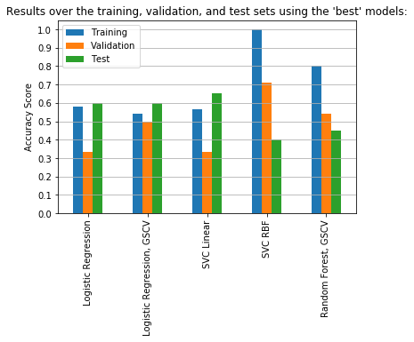
Conclusions
The logistic regression and SVC with linear kernel witness unusual results in that performance is actually best on the test set. Likely this is due to chance on the part of the test set. By contrast, the SVC with RBF kernel and random forest models perform as expected – the best performance is on the training set, with declining performance on the validation and then on the test sets. Unfortunately, the accuracy witnessed on the unseen sets is such that one would have to think twice about launching a trading strategy using the given features and the given models.

Slide 17
Conclusions
This project can be revised with the following considerations in mind:
alter the lengths of the training, validation, and test sets: perhaps a shortened training set and lengthened validation and test sets would give rise to more favorable performance. However, that performance was uninspiring using 200, 24, and 20 months for the sets, respectively, suggests that altering the lengths should not be the only consideration, if at all.
add or delete features: all but one of the features are macroeconomic and not directly connected to the constituents of the two portfolios. Even though macroeconomic data is readily available from many sources, its ready availability generally prevents any one financial participant from acting on the information so as to earn considerable returns relative to other participants. Perhaps including more stock-level data might better reflect the unique nature of each portfolio so as to differentiate them. Fundamental metrics like price-to-earnings-per-share, price-to-book-value, etc., might be explored.
different classification models: Bayesian models were not attempted in this project. To do so, distributions would need to be fit to each feature, rather than merely accept the feature data “as is.”
alter the periodicity of the data: shortening the periodicity to weekly or daily would immediately increase the number of observations. However, many of the macroeconomic data are reported monthly, and not one of the features is updated daily. Daily or weekly imputation would be needed, but then the issue arises as to what imputation method is most appropriate.

